Slide 1


BREXIT
“this deal, no deal; or no Brexit at all”
Theresa May, 14th November 2018

Slide 2
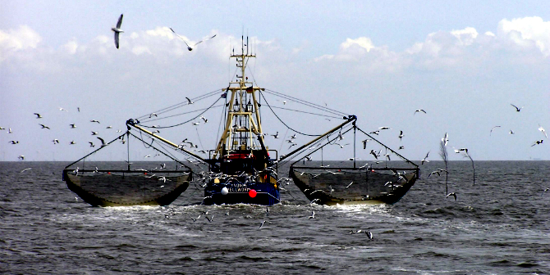
Trade after Brexit
Long term trade arrangements remain outstanding
Trade deals to be agreed during the 21 month transition period.
Protection for “geographical indications”- PGI products
Fisheries – remains controversial

Slide 3

Procurement Regulations
No imminent change.
Applied to sign up to WTO GPA which regulates trade across 165 countries
Same principles would apply to us as countries like Canada and Japan
Accreditations such as ISO and BSI would continue to be recognised in the UK
Professional qualifications would continue to be recognised in UK
Data Protection Regulations will continue
Scope in the future to loosen the red-tape

Slide 4

Impact analysis suggests that …..
Weaker £ sterling will continue to drive up inflation
Additional Cost Pressures Living Wage
Business rate increases
Continued margin pressure
Workforce issues
Border issues with appropriate vehicle checks
Scotland Excel have contacted all food suppliers for impact analysis statements… however Brakes is likely to have major impact across councils

Slide 5

Preparation is key ….
When tendering, ensure you write in Currency fluctuation clauses
Ensure you check closely the financial implications of trading abroad – including checking the credit rating of the supply chain
Ensure clauses written into contracts to mitigate any broken trade deals
Business rate increases and Living Wage implications to be considered
Ensure both your own workforce and those of supply chains taken into consideration before embarking on large projects
Ensure some form of payment protection built in
Renegotiate EU agreements – Some suppliers claiming “ Force Majeure “
Have suitable contingency built in for exit strategies
Ensure suppliers contacted for contingency planning

Slide 6

SXL White Paper, Commodity specifics & next steps …..
Published online for Members
Informative, general overview
Highlight areas of concern within our framework portfolio
Supplemented with category specific reports – we now hold list from Brakes regards potential impacted items with country of origin
Reactive to ongoing negotiations/developments
Planning to invite catering managers and nutrionalists to meet up and create a “plan B “ school menus if shortage of products materialises

Slide 7




Contact me
Lesley Richard
Strategic Procurement Manager
Email: lesley.richard@scotland-excel.org.uk
www.scotland-excel.org.uk
@ScotlandExcel
www.linkedin.com/company/scotland-excel

