Slide 1
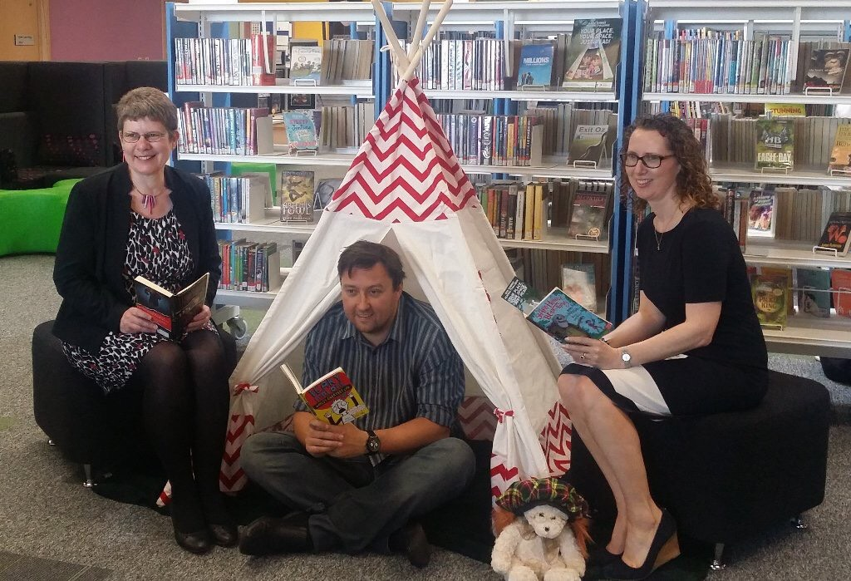
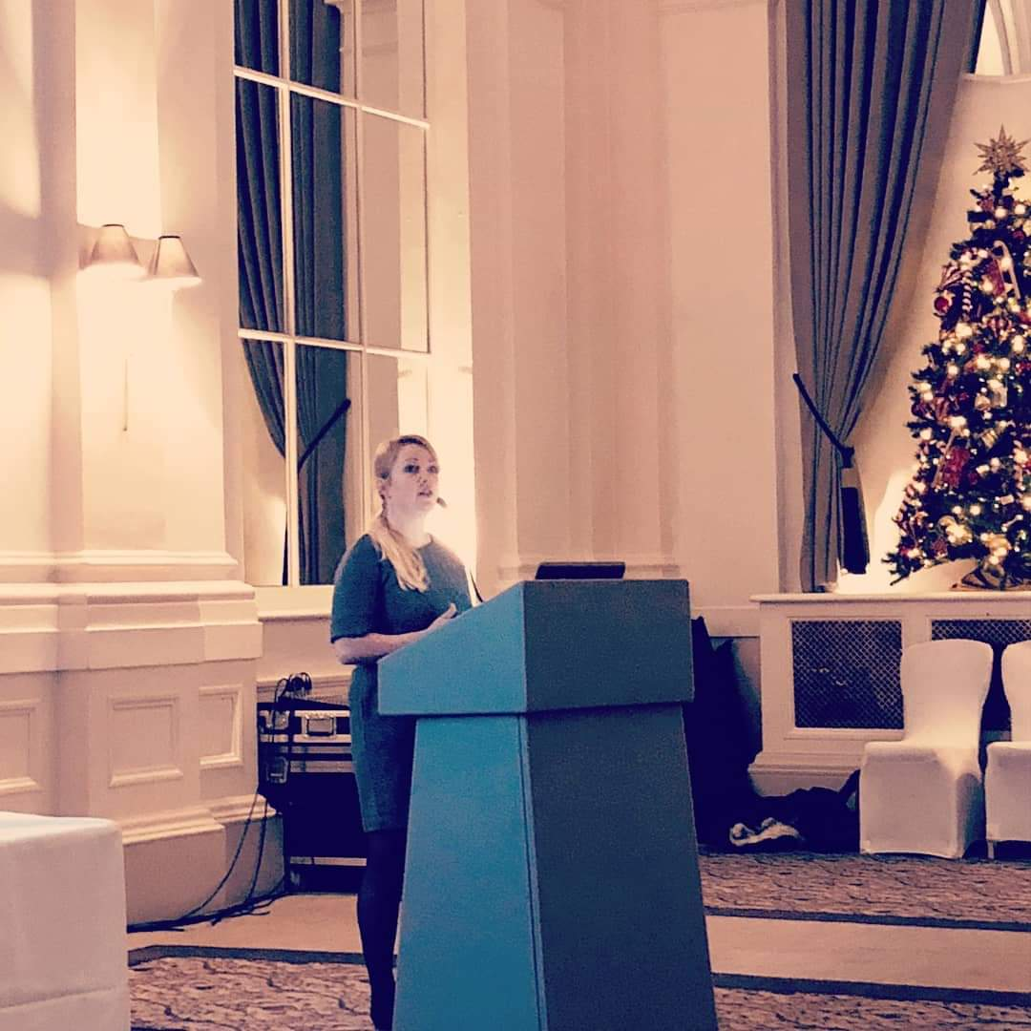
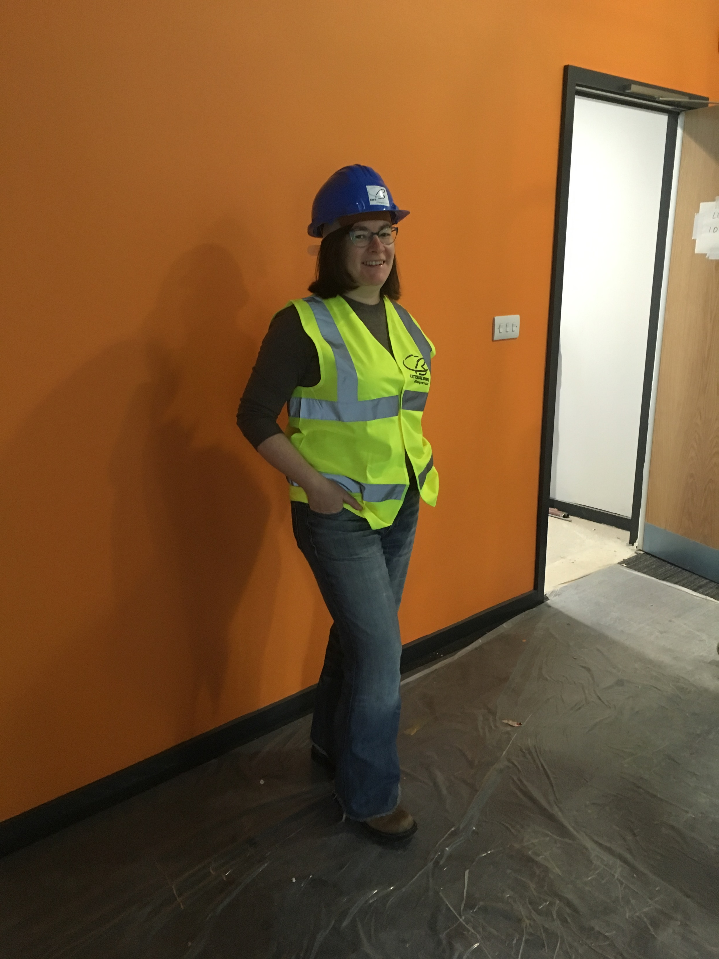
How is a Councillor Elected?
Notes:
These pictures show Councillors going about their daily business.

Slide 2
Who can be a Councillor
You can’t be a Councillor if you:
Work for the council you want to be a councillor for, or for another local authority in a political restricted post
Are the subject of a bankruptcy restrictions order or interim order
Have been sentenced to prison for three months or more (including suspended sentences) during the 5 years before election day
If this is you, you may not be able to be a Councillor but remember there are lots of ways to engage with democracy and your voice within it is always important and welcome!
There are a few criteria that you must meet in order to be a Councillor:
Councillors must be:
British or a citizen of the Commonwealth or European Union
At least 18 years old
Registered to vote in the area or have lived, worked or owned property there for at least 12 months before an election
More information on becoming a Councillor is provided by the Electoral Commission: www.electoralcommission.org.uk
Notes:
Please emphasise that most people can stand as a Councillor, however, if you can’t your contribution to local politics is equally valid and important . Place particular emphasis on different ways individuals can engage with political systems as you progress through the toolkit.
As of February 2020 there had been no change to citizens of the European Union being able to stand for local elections.
The Scottish Elections ( Franchise and Representation) Bill was also passed in February 2020. When this comes into force it will allow foreign nationals to stand for local election where they have indefinite leave to remain or pre-settled status.
Please check Electoral Commission information if you are uncertain as to whether or not you are able to stand.

Slide 3
How do you stand for election?
You must complete and sign a simple nomination form and have it signed by a witness.
Councillors usually campaign to maximise the number of people who might vote for them. This often involves leafleting or going door to door to generate support.
Candidates often seek help with their campaigns from friends, family and political parties.
Councillors need to record what they spend on their election campaign, and all donations and that these came from acceptable sources.
The community then votes for the person they believe will represent them best.
If you have decided to stand for election you can go about it in two ways:
You can stand for a political party. If you do this you must be a party member and go through internal selection processes
Or
You can stand as an independent. 16% of Scotland’s Councillors are independent and not affiliated with any political group.
Notes:
Key learning: the process of standing to become a Councillor is not complex and there are other people who will help you navigate it.
Note: if you stand with a political party you should align with their values and what they hope to achieve for your community. Your party may offer support in campaigning and advise on how to stand for election.
If you stand as an independent support is available through other organisations.
Set a question for the group: what sort of issues do people campaign on? What sort of campaigns are likely to be the most successful?
To find out what sort of work Councillors do if they are voted in, continue through the exercises within the toolkit.

