Slide 1

Local Government in Scotland
Notes:
Before moving to the next slide ask the group what they think a Local Authority is. For politically engaged groups set them a challenge and see how many they can name in pairs.

Slide 2
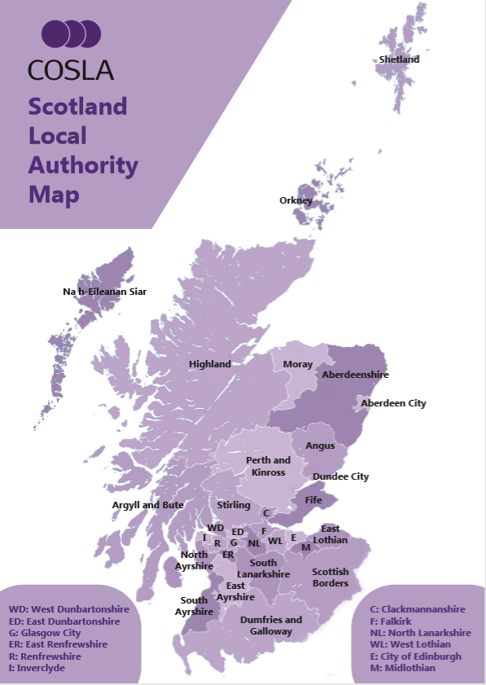
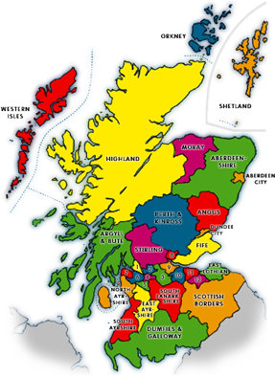
What is a Local Authority?
There are 32 Local Authorities in Scotland with identical functions and powers.
Each Local Authority provides public services, including education, social care, waste management, libraries and planning.
Each Local Authority is different in size and population and may have different needs.
Councils operate independently of central government and are accountable to local people for the services they provide.
Notes:
Work through the points.
Ask the group to imagine they have to plan education provision for Glasgow and for the Western Isles. What might be the different things they need to think about? E.g. number of pupils, teacher availability , different languages and cultures. Differences between areas are the reason why different Local Authorities often make different decisions , ensuring that the needs of their local people are met.

Slide 3
Key People
Elected Members
Councillors are elected by their communities to represent them and make decisions on their behalf.
Administration is the group of elected Councillors that represent the majority and control the running of the Council.
Council Leader: A Council Leader is elected by the party that forms the administration. Some Councils decide to have Co-Leaders who share this responsibility.
Civic Head: the Council will also elect a civic head that will represent them at events. This person is a Lord Provost or Provost.
Non Elected Members
Chief Executive: the Chief Executive is normally the head of paid staff and is employed by the Council.
Officers: officers are employed by the Council to carry out its functions.
Notes:
Ensure the group understands that there is a difference between elected members of the Council who are elected by local communities to make decisions on their behalf and council officers who are employed to carry out it’s functions.

Slide 4

Funding
Local Authorities receive funding from Scottish Government.
They generate their own income through Council Tax and other agreed taxes.
Councils may generate income by charging for some local services.
This funding is used to fund all Council services and staff.
Together Councils had £15.2bn total income in 2016/17 (£2bn local tax revenue)
Across Scotland, Local Authorities impact in every community:
  244,000 staff – 10% of working population
  £6.3bn annual procurement
  £250m annual investment in local economic growth
  £787m Capital Budget
Notes:
Key learning – your Council is responsible for managing significant budgets on your behalf and in doing so provide a large number of jobs and contribute to economic growth. Even though this is a large sum of money, the services communities require are often costly and Councils have to make difficult decisions about how this money is spent.

Slide 5
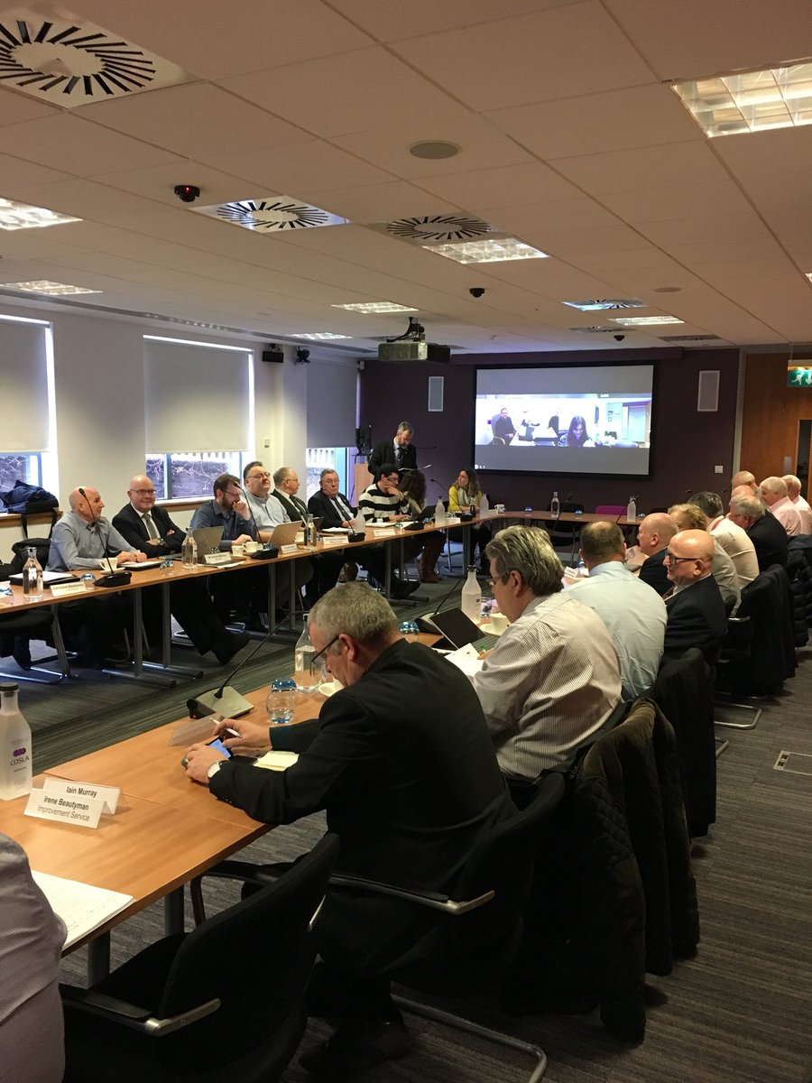
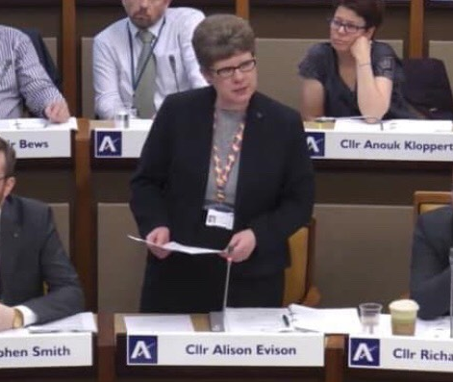
Decision Making
Full Council Meetings
At full Council meetings Councillors meet to debate key issues and take decisions on behalf of their communities. Setting the annual Council Budget and the rate of Council Tax are always decided by full Council.
Committee
The Council might decide that decisions on other issues can be taken by committees or sub committees, for example decisions on youth services or the environment.

Slide 6
Why is Local Government Important?
Councils put communities and their people first in the design of local services
They provides community leadership
They deliver the vast majority of public services in local areas, impacting the lives of everyone.
How does your Council work for you?
Notes:
Having finished the presentation move on to the film within the toolkit or begin the exercises to answer the ‘ how does your Council work for you?’ question.

