Slide 1
COSLA
‘working for you every day’
2023-2024

Slide 2
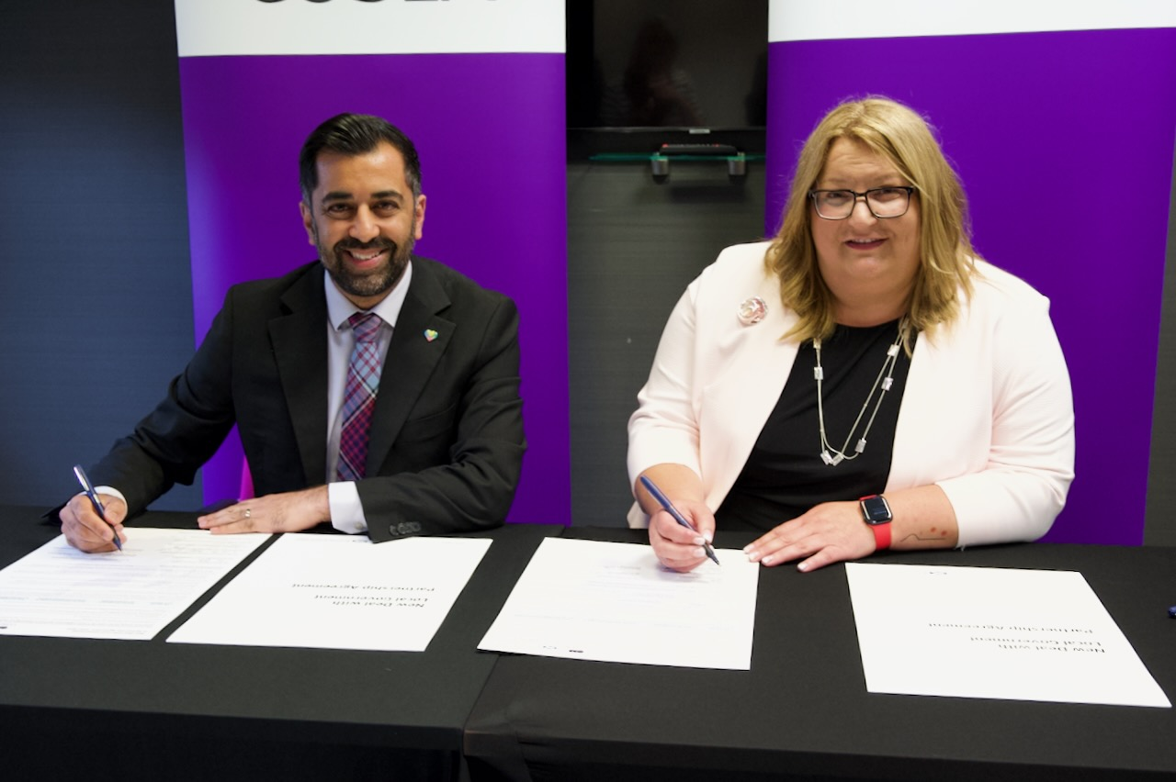
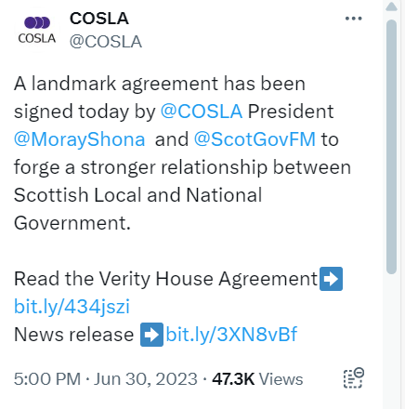
First minister and COSLA sign ‘historic’ new deal for councils
Working as equal spheres of government...

Slide 3
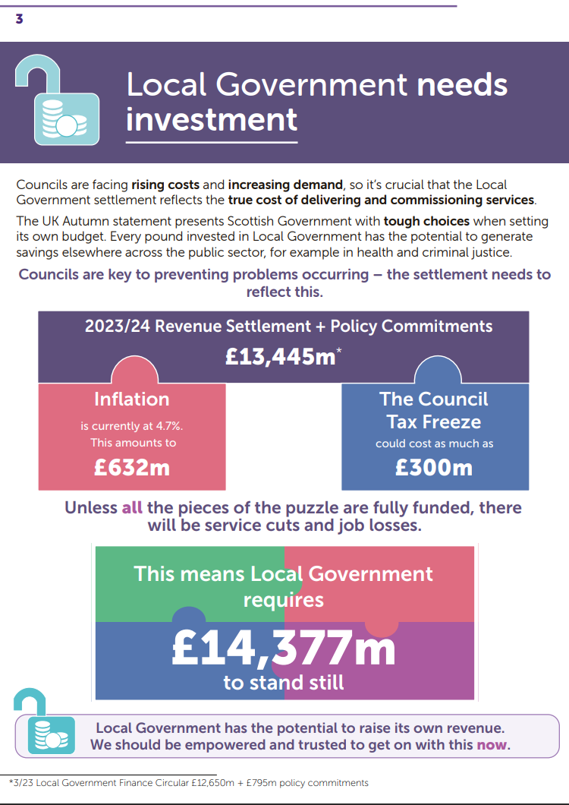
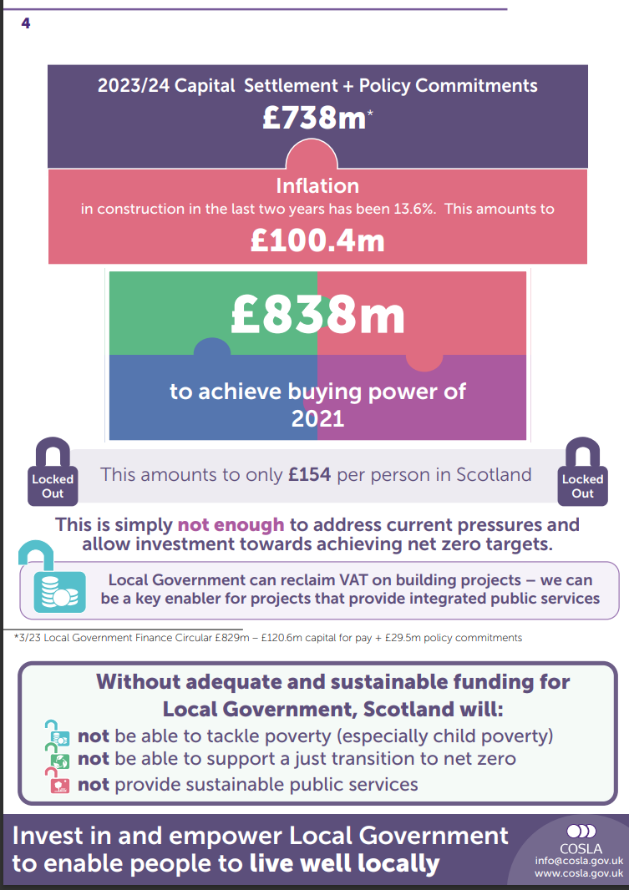
Budget Lobbying Documents...

Slide 4
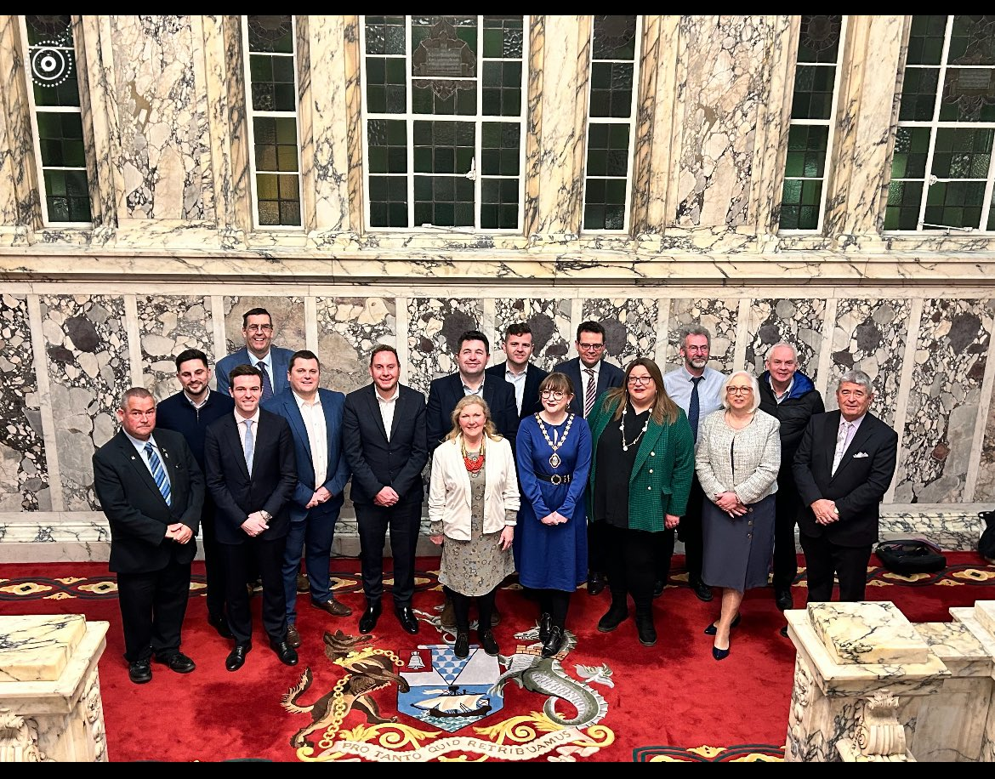
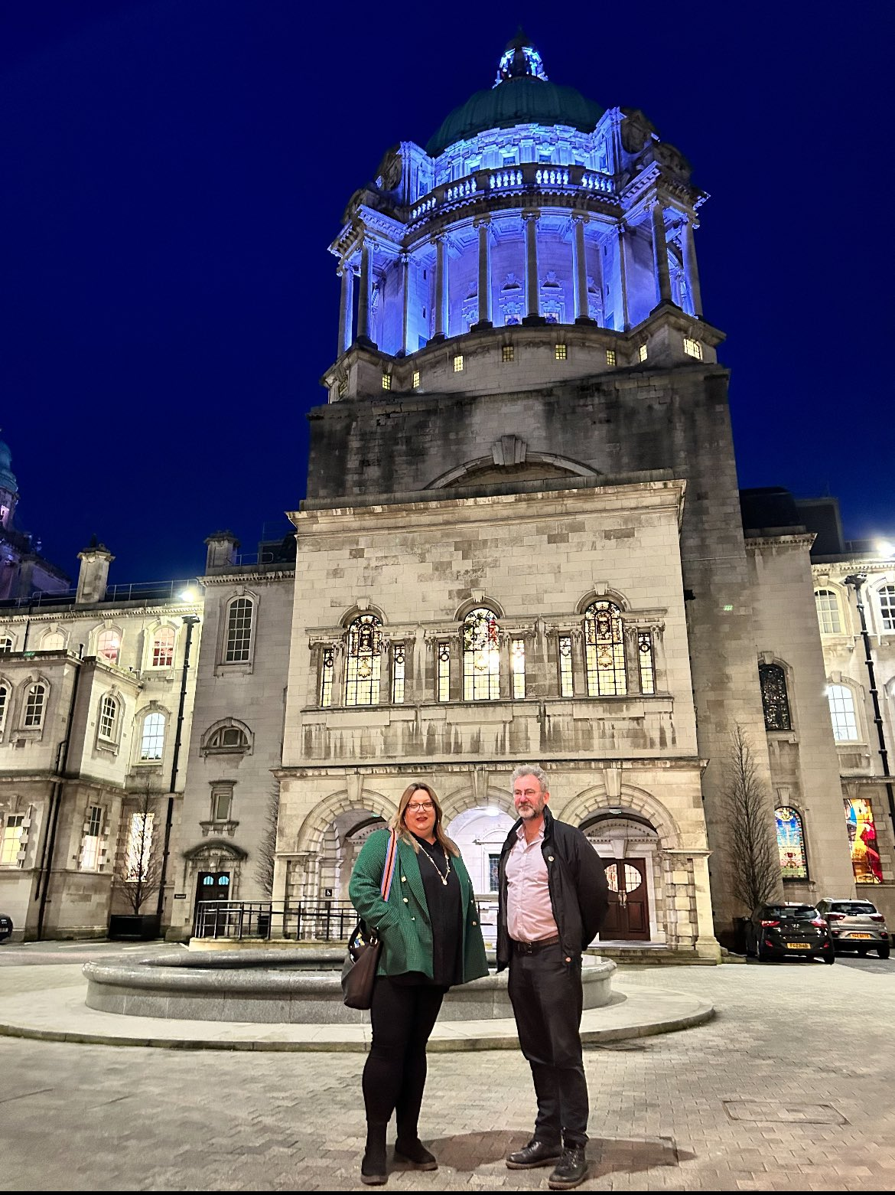
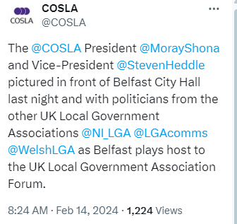
Engaging with our Local Government colleagues across the UK...

Slide 5
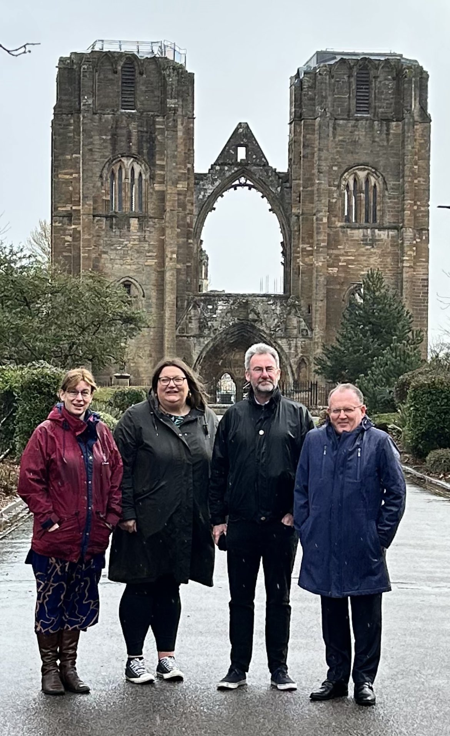
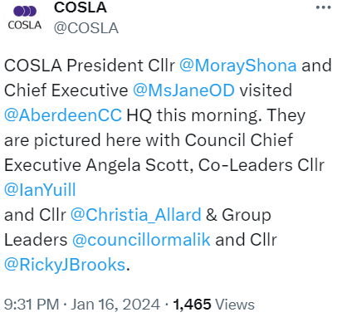
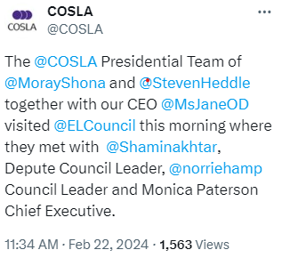
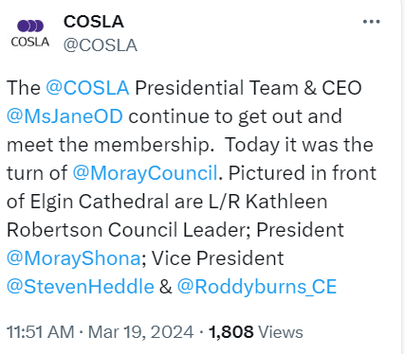
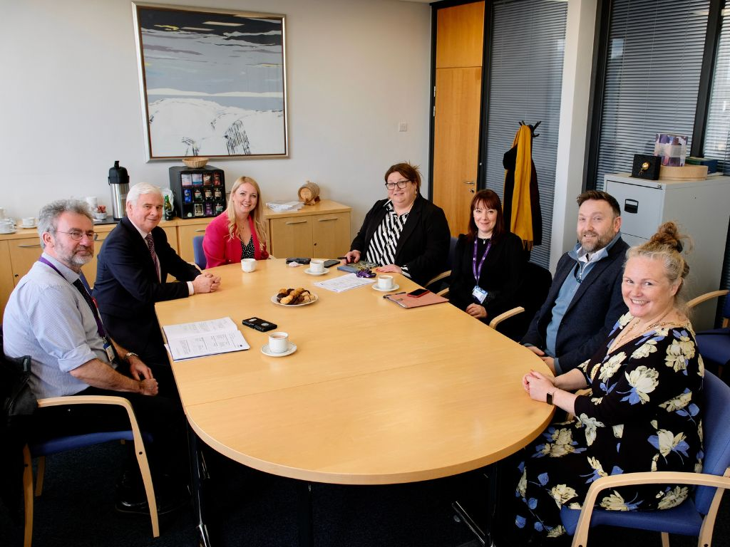
Presidential Council Visits to hear your views and respond to your needs….

Slide 6
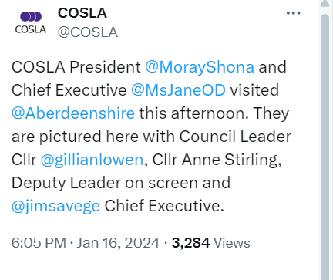
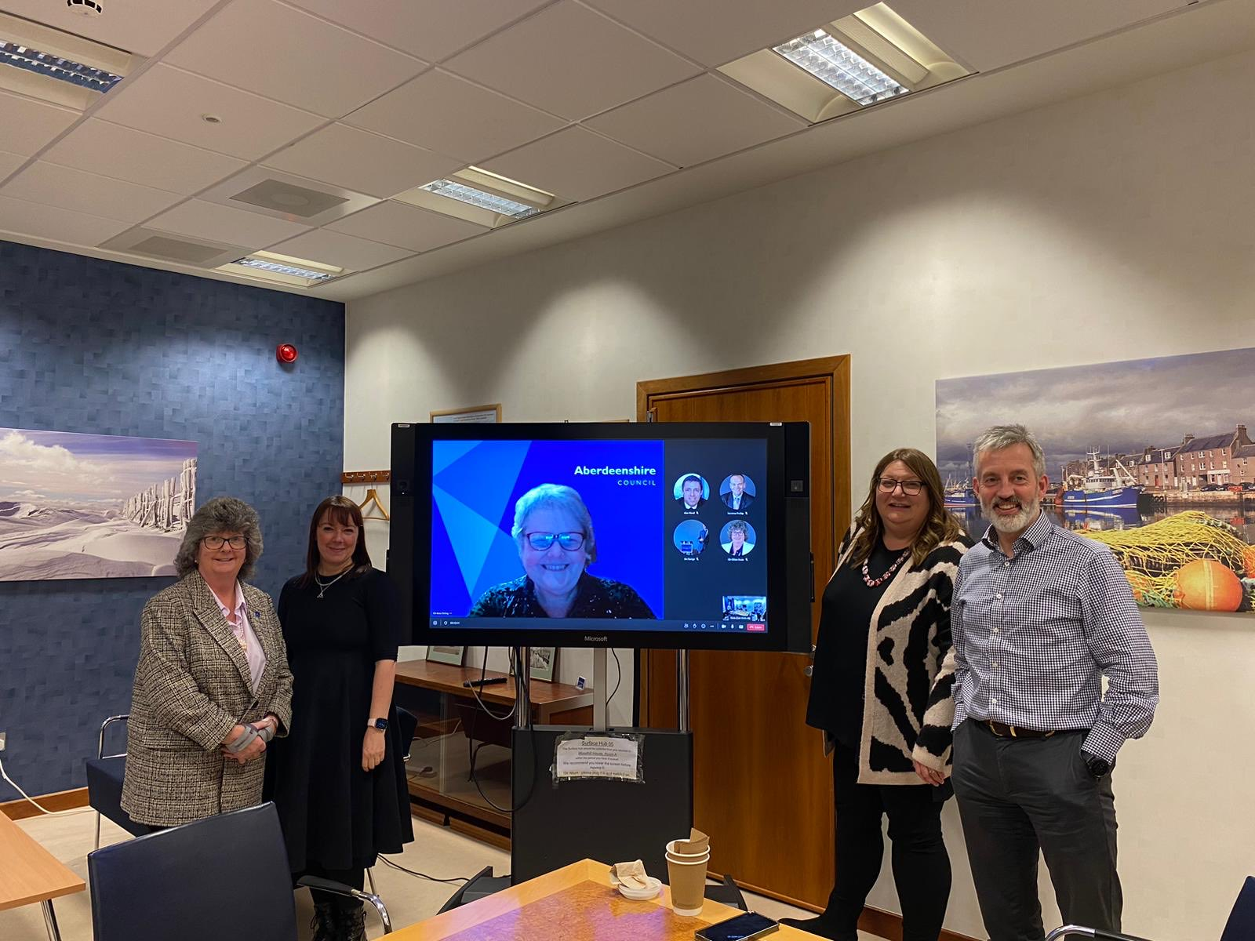
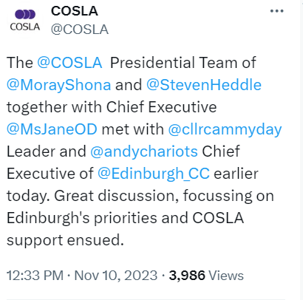
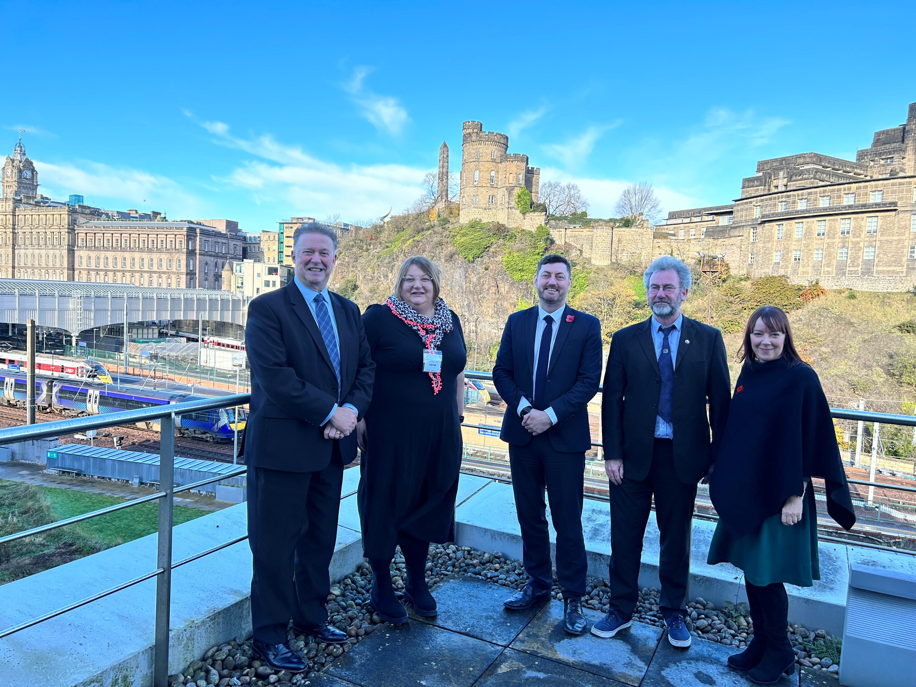
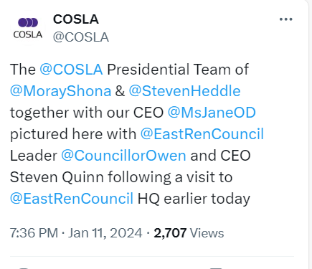
Presidential Council Visits to hear your views and respond to your needs….

Slide 7
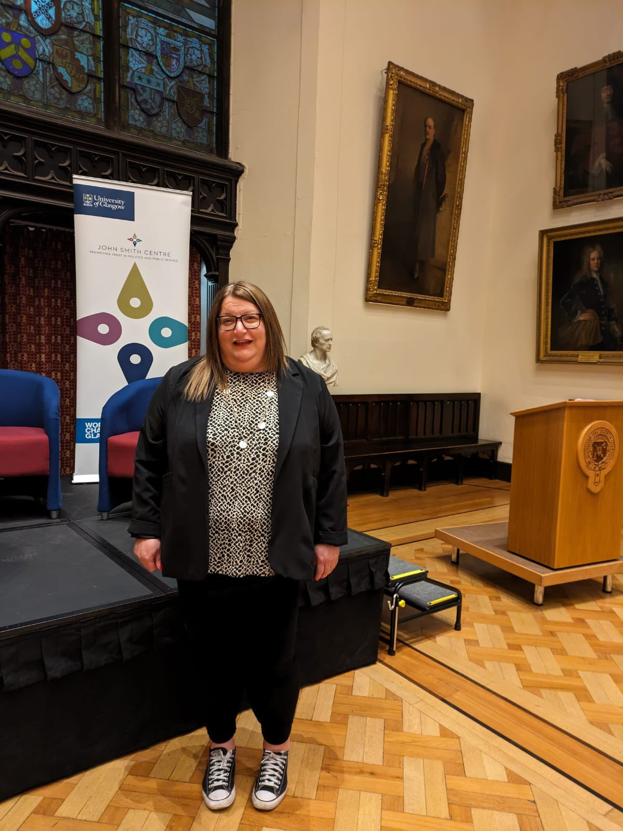

Slide 8
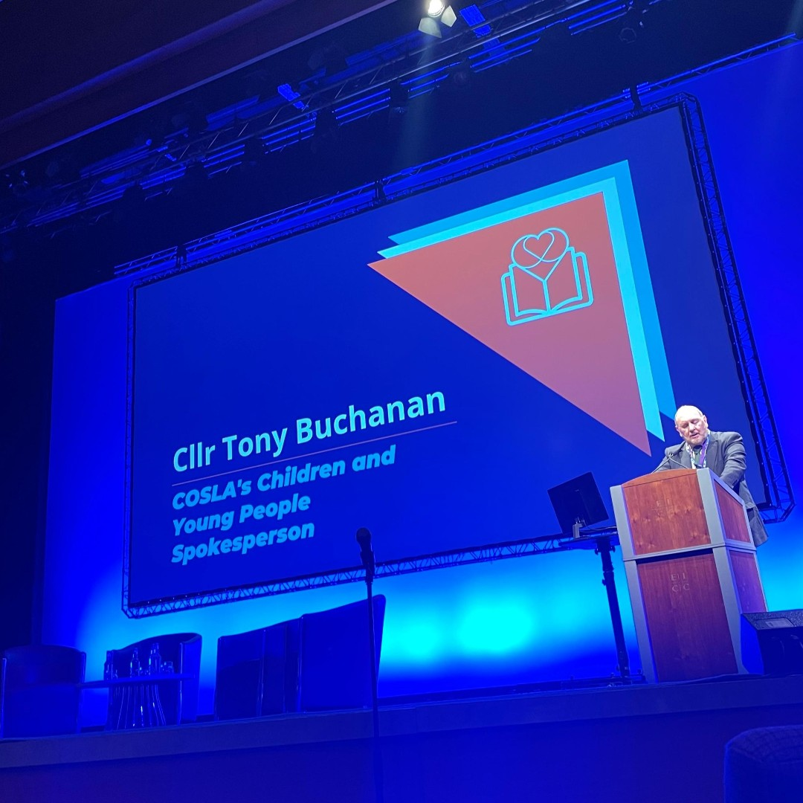
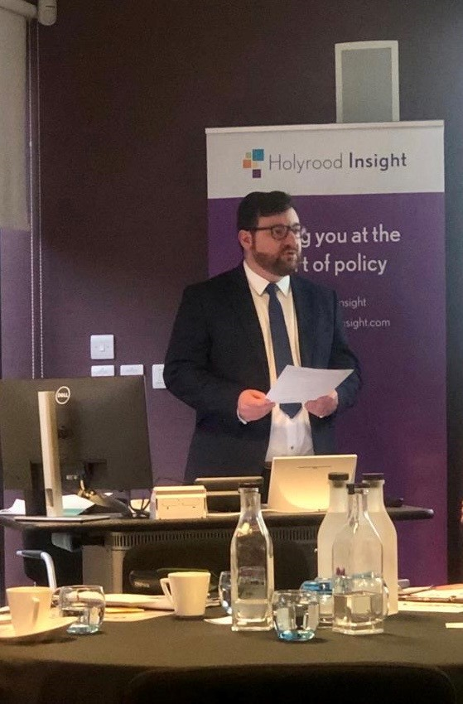
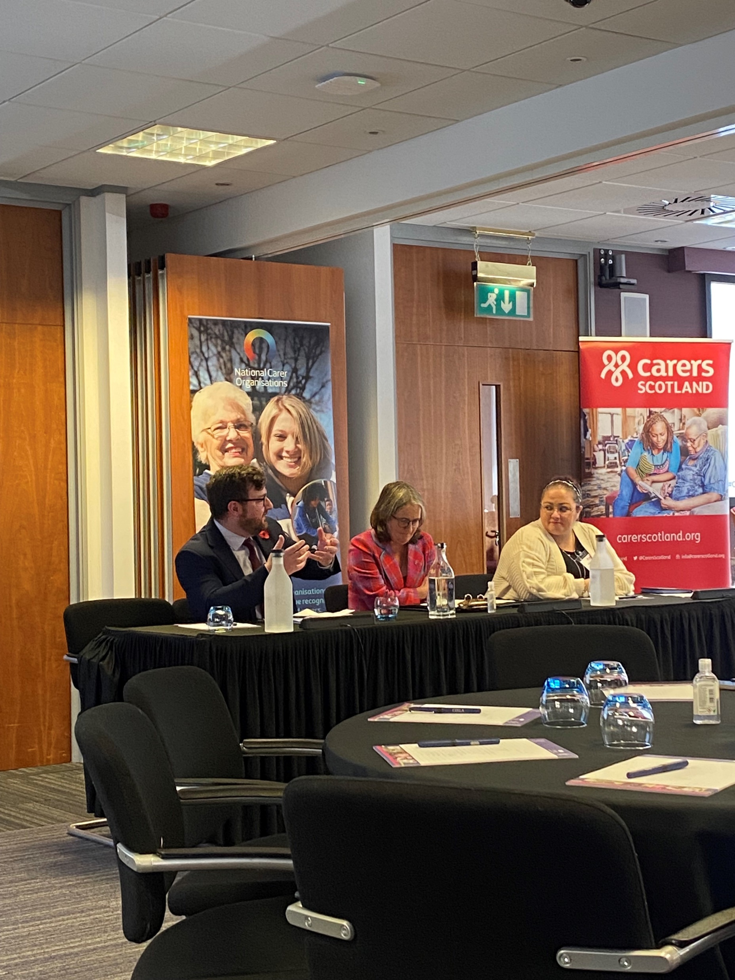
Demonstrating our commitment to our communities, ‘Keeping our Promise’…
Engaging with our stakeholders nationally…
Standing up for our young people and future generations….

Slide 9
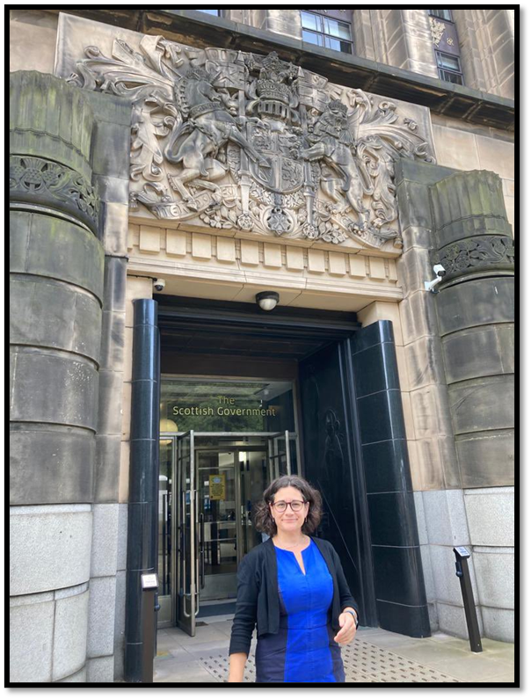
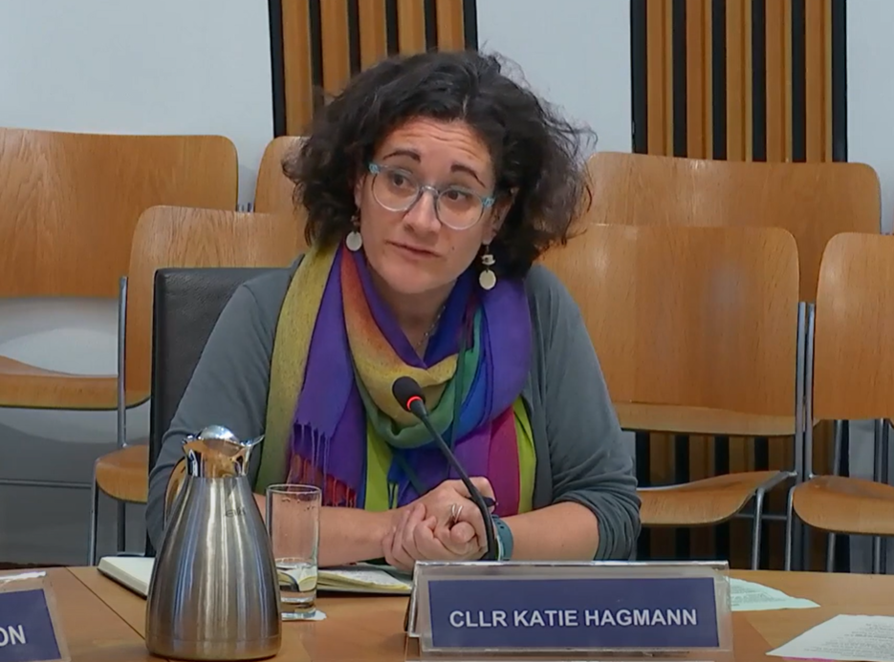
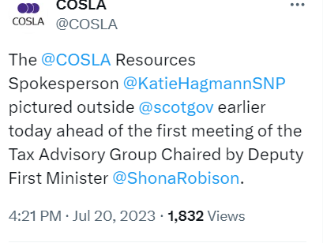
Local Government, Housing and Planning Committee, Tuesday 26th September 2023
Giving evidence to Parliament and lobbying for Scottish Local Government…
Representing the best interests of local government ….

Slide 10
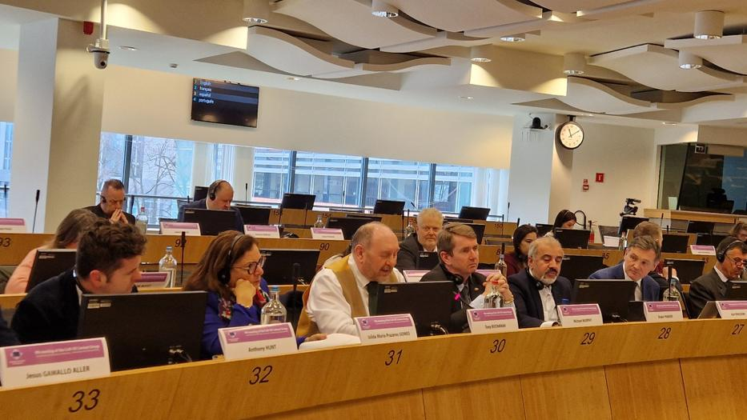
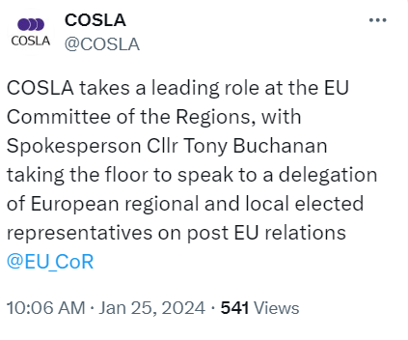
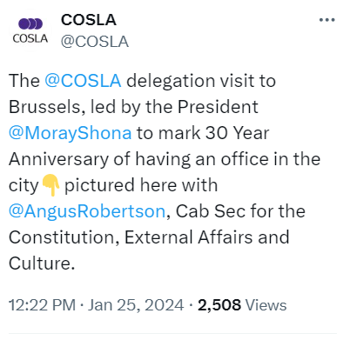
Representing Scottish Local Government in Europe for 30 years...

Slide 11
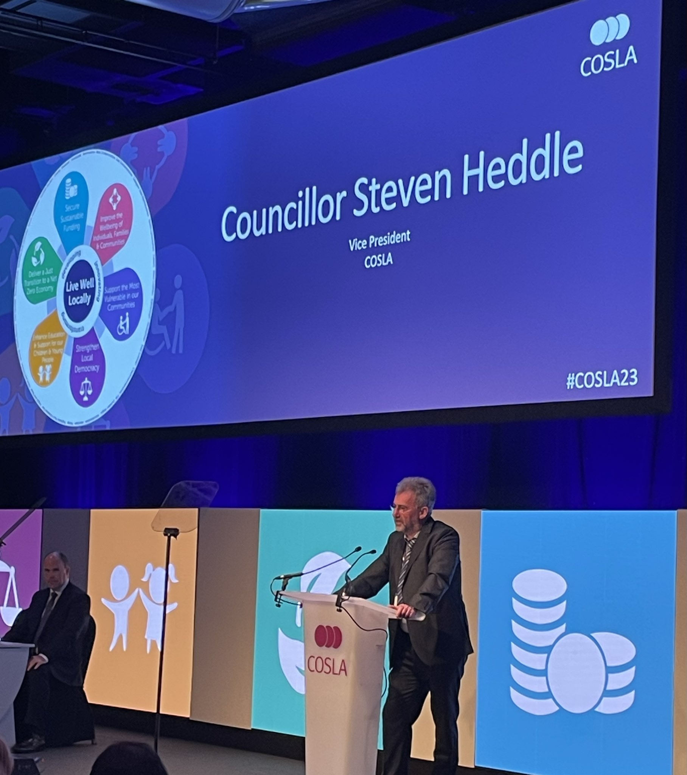
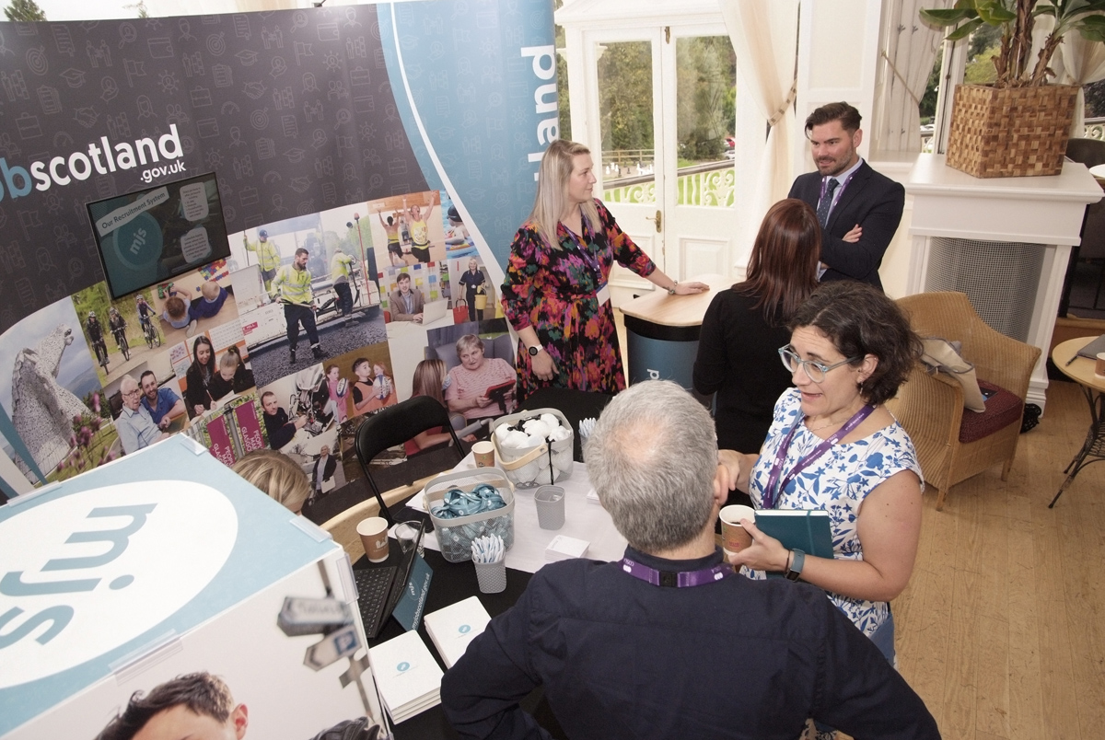
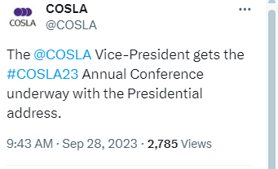
Providing the largest annual platform to raise the voice of Scottish Local Government…

Slide 12
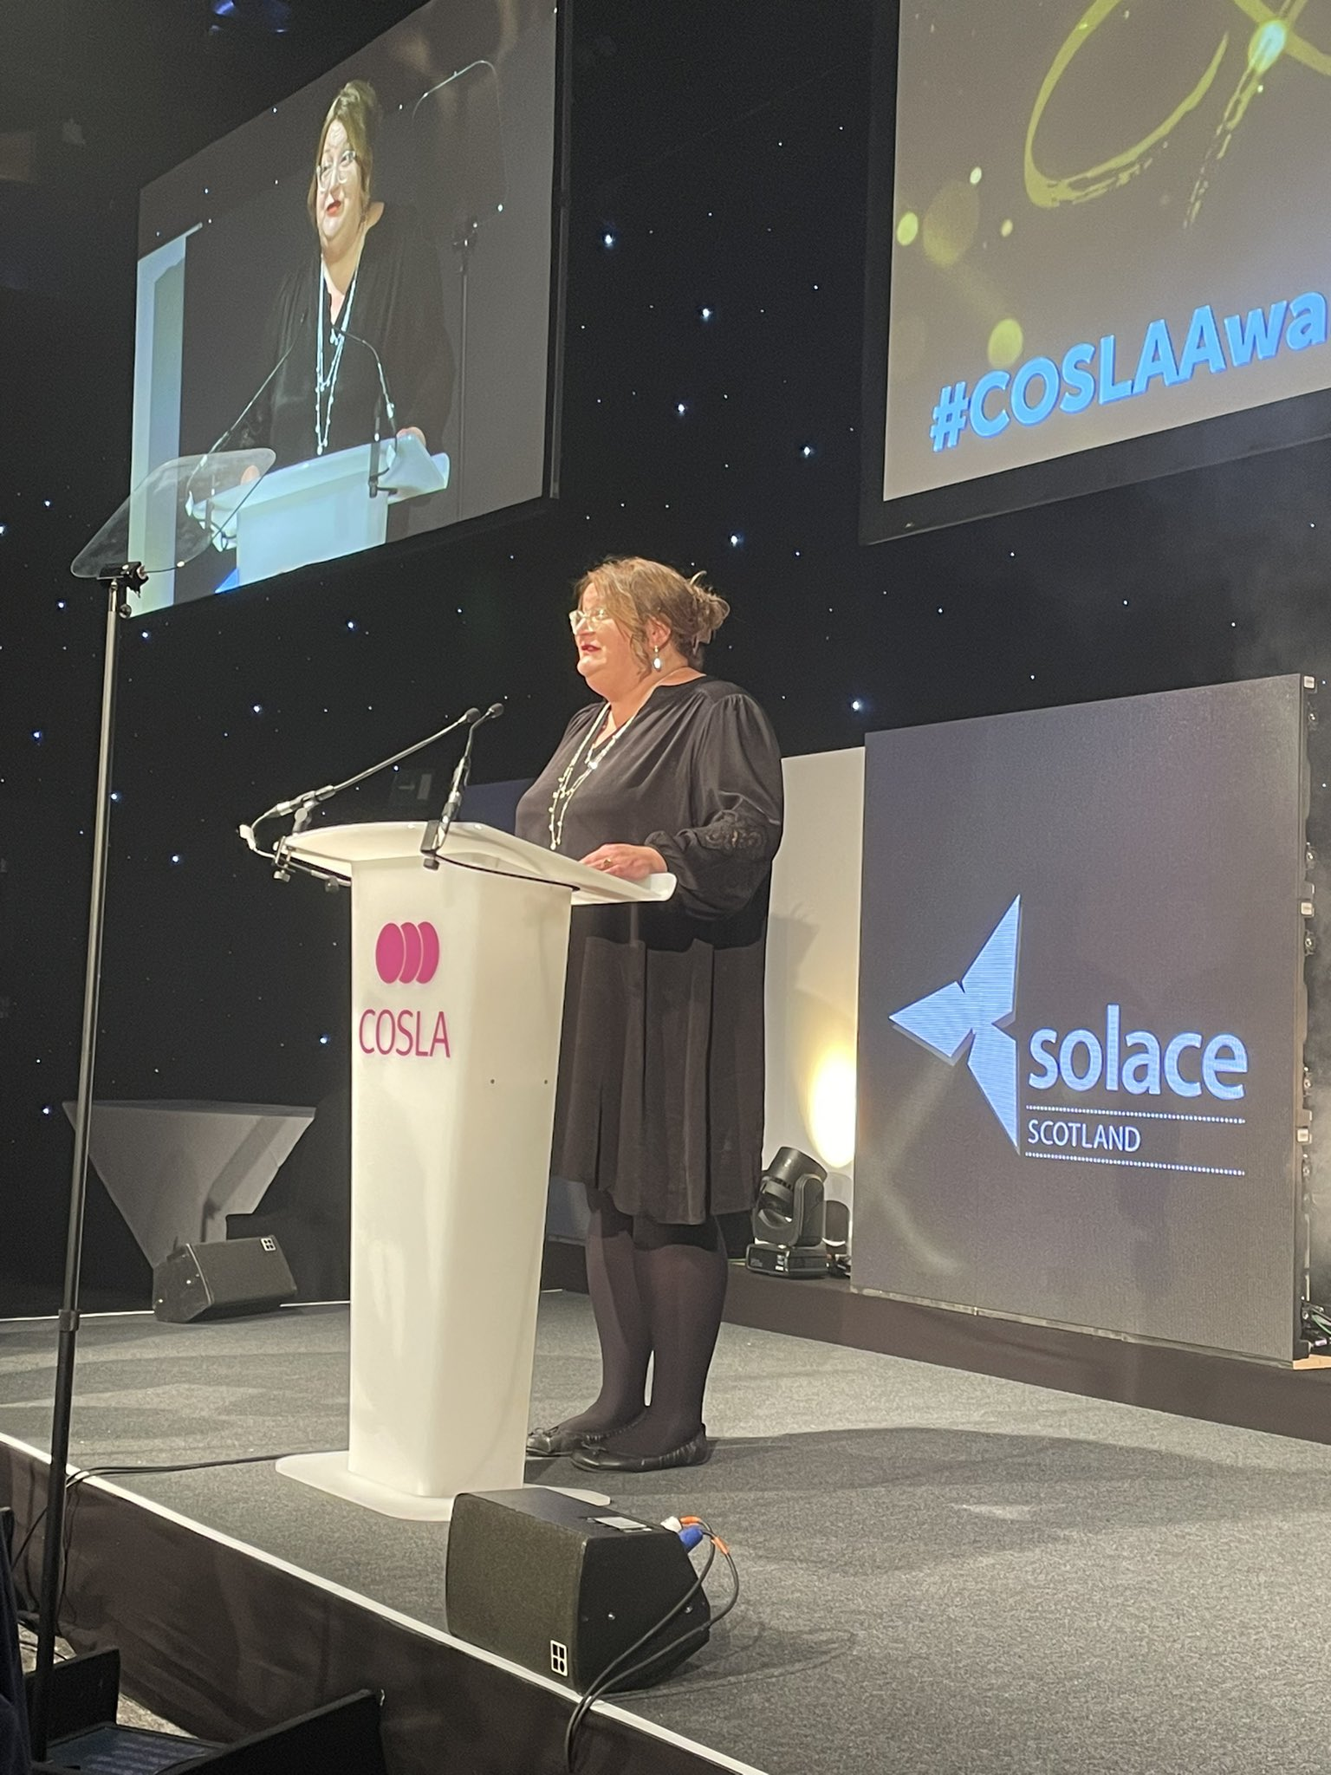
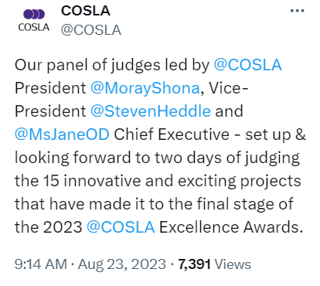
Recognising and showcasing the excellence in our councils…

Slide 13
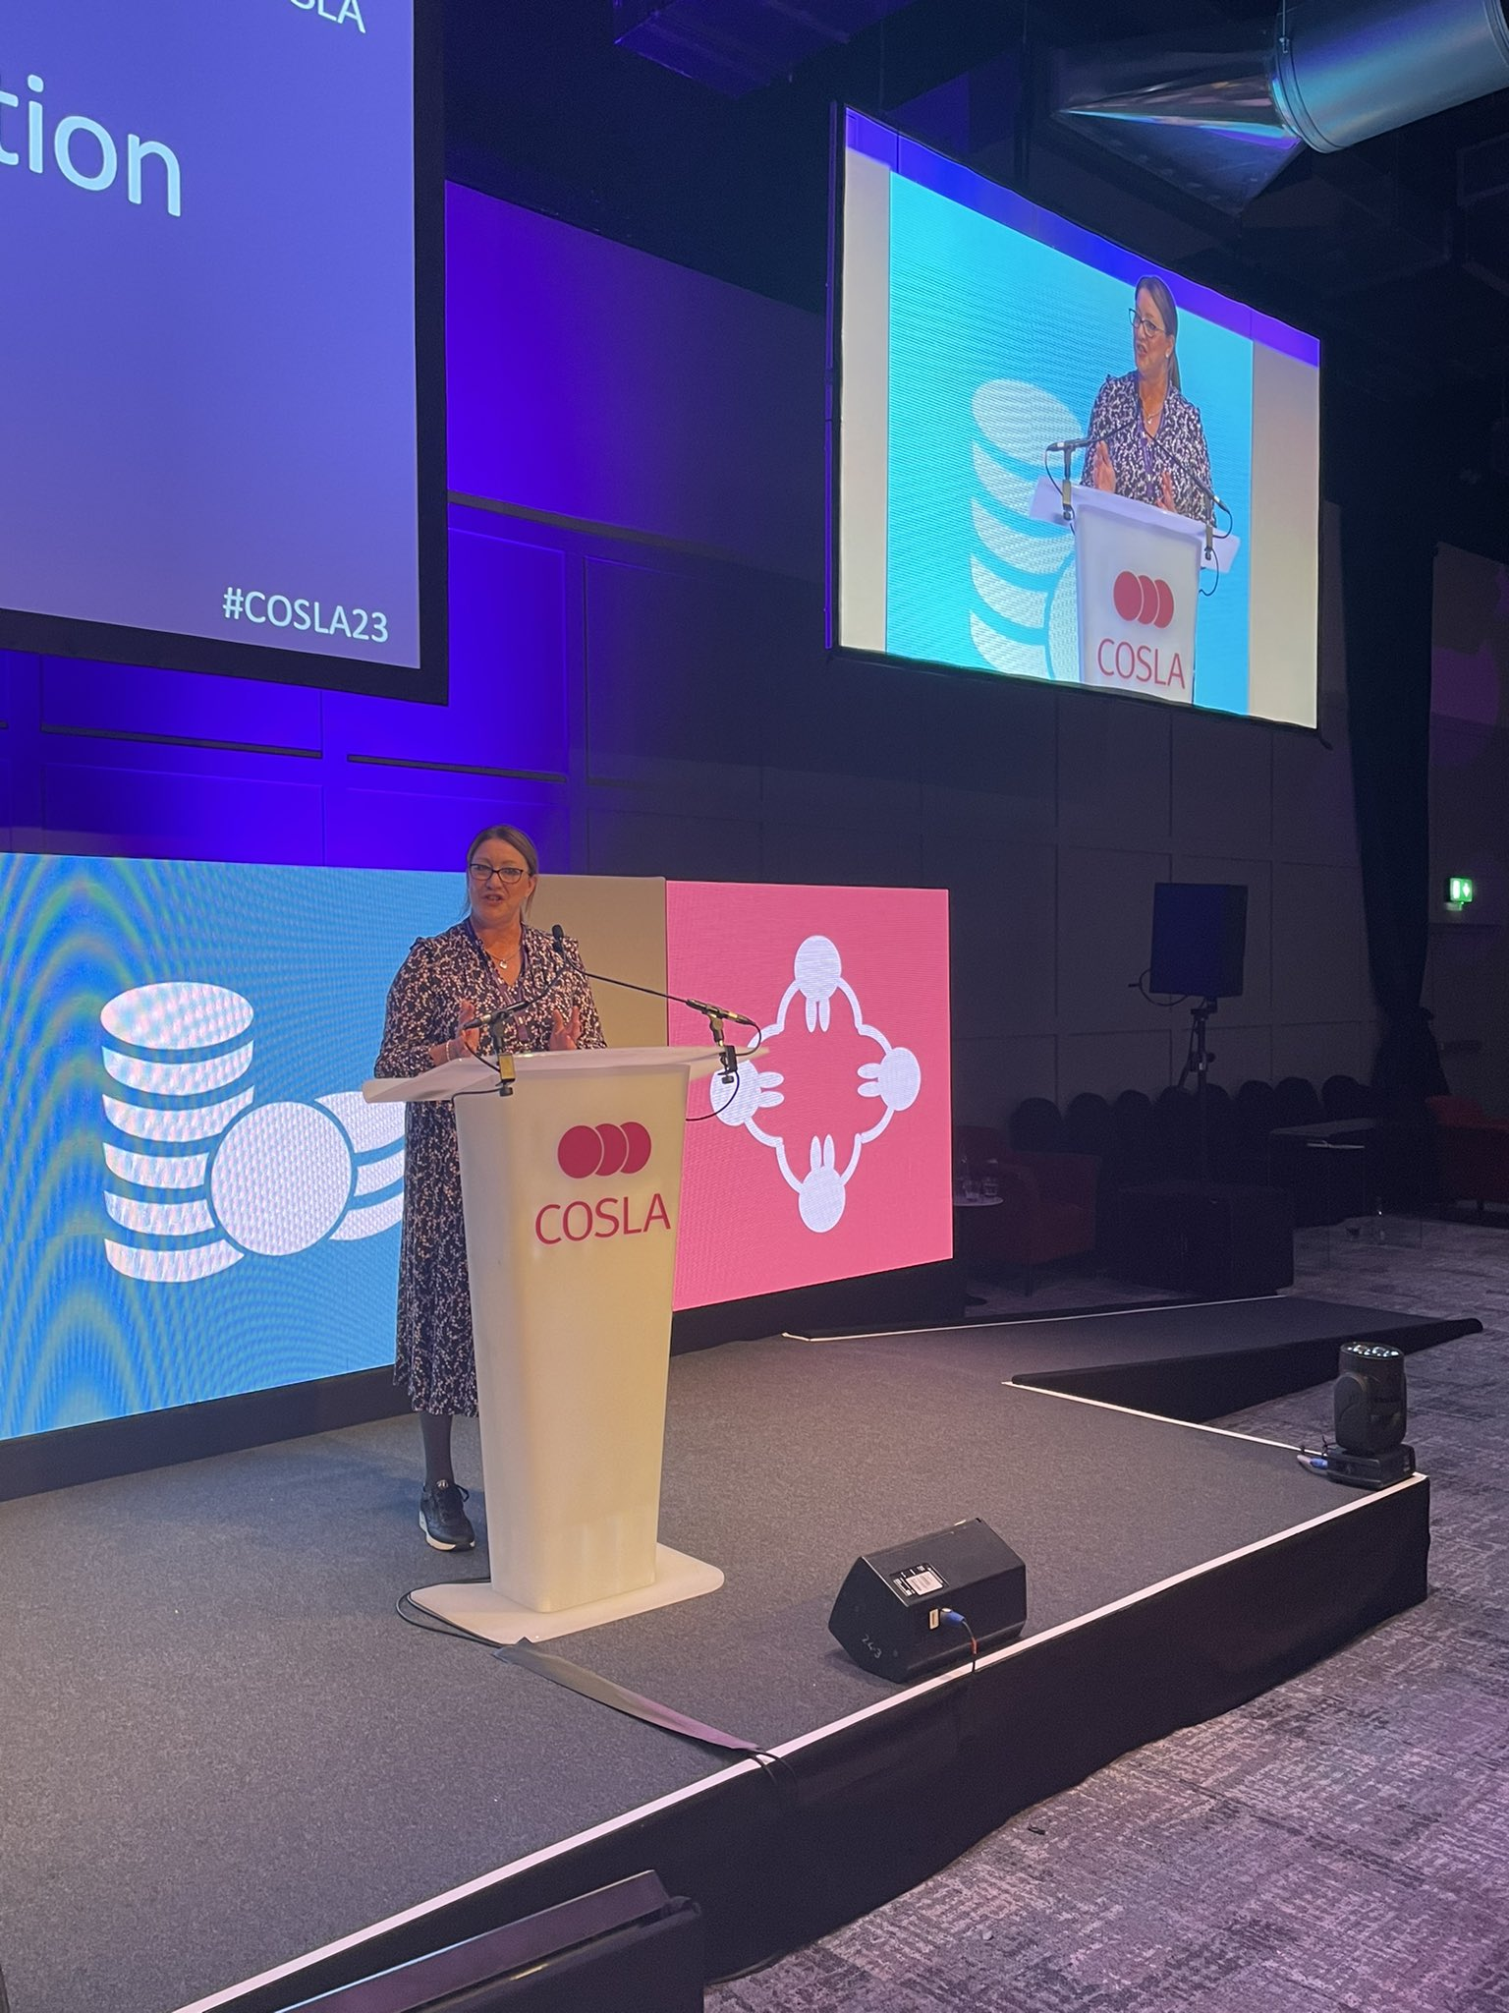
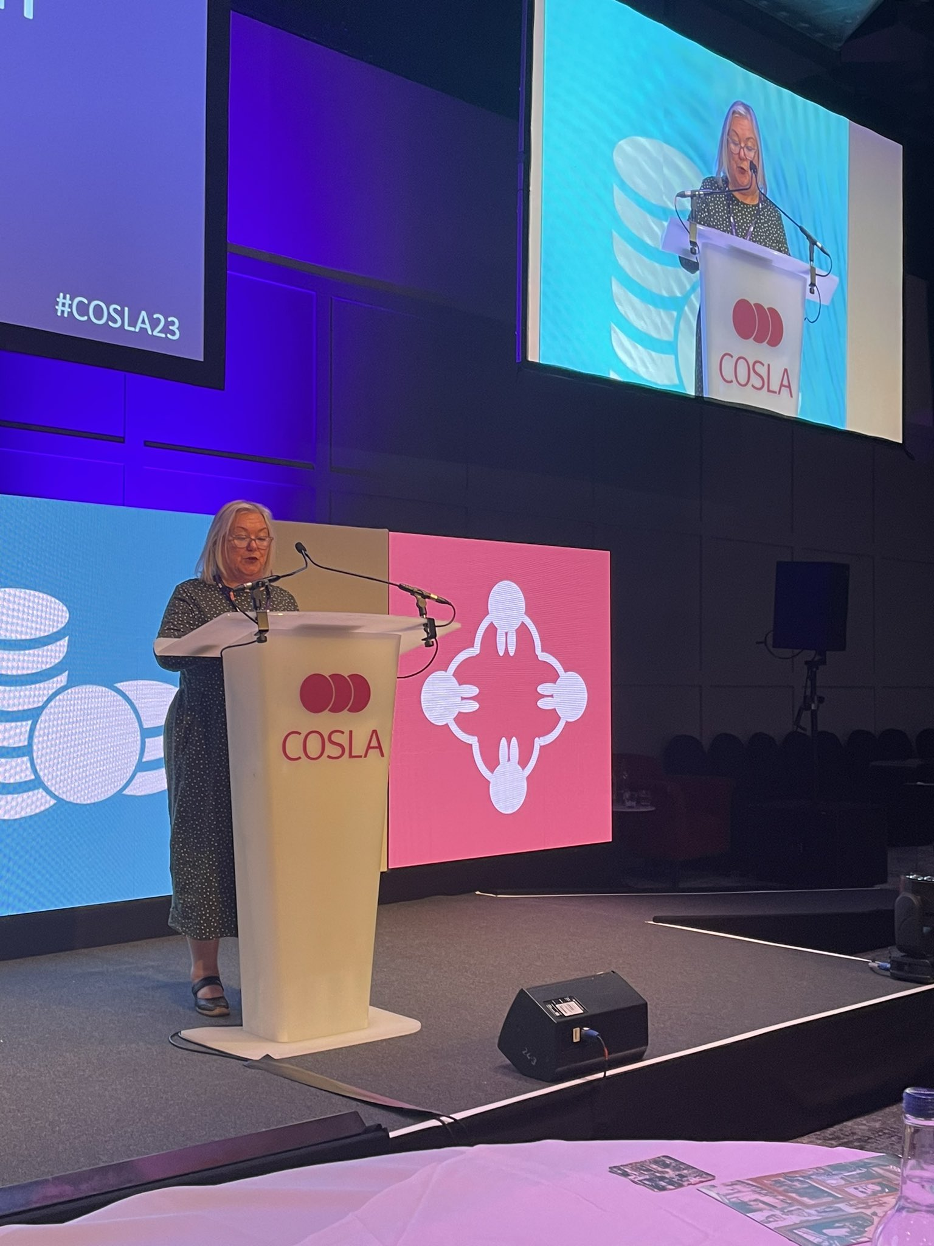
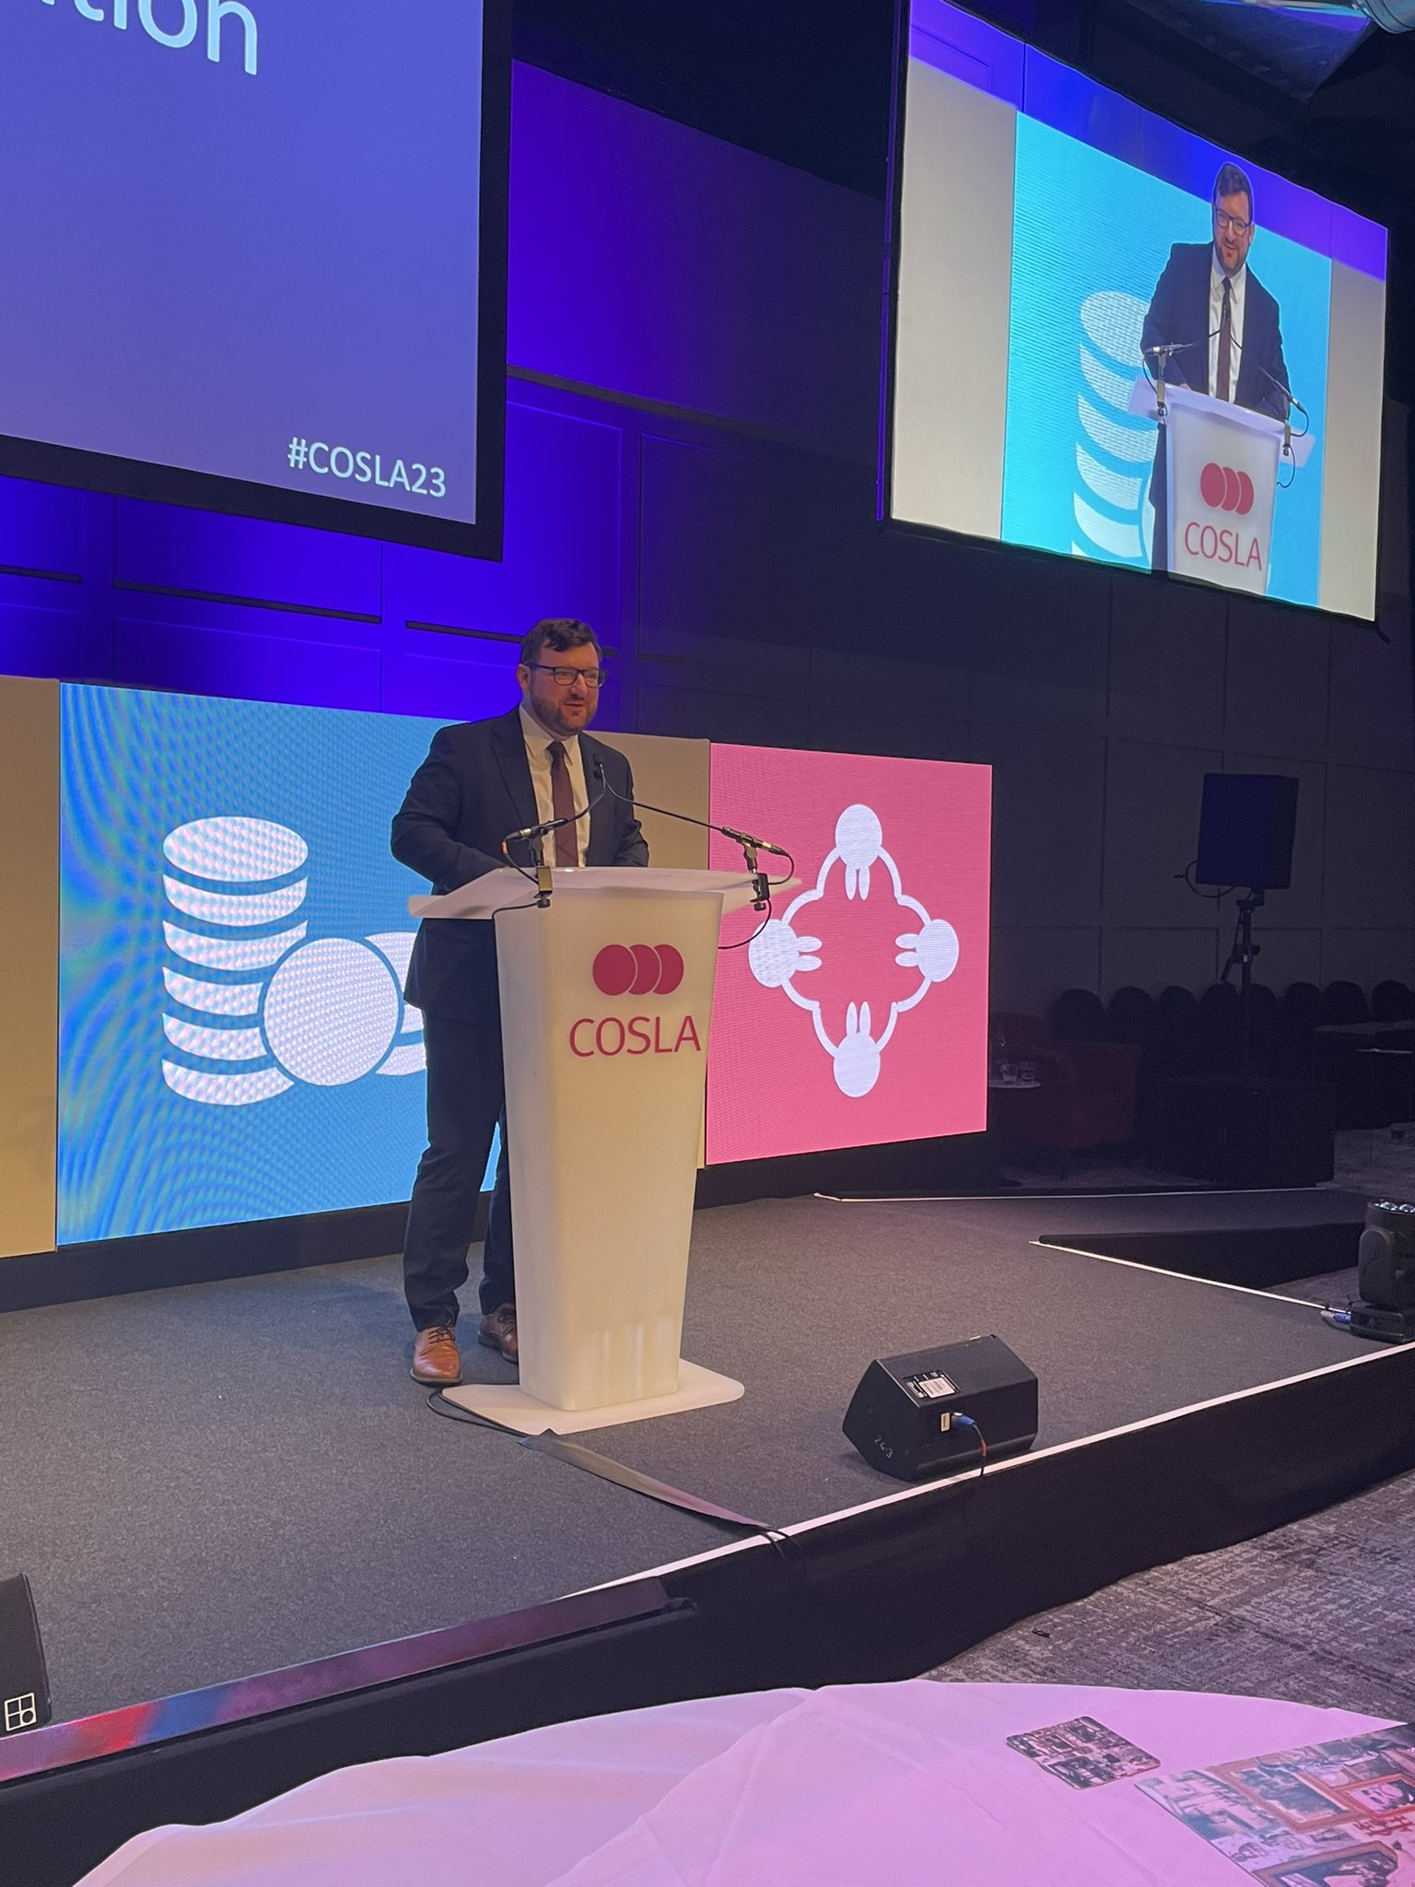
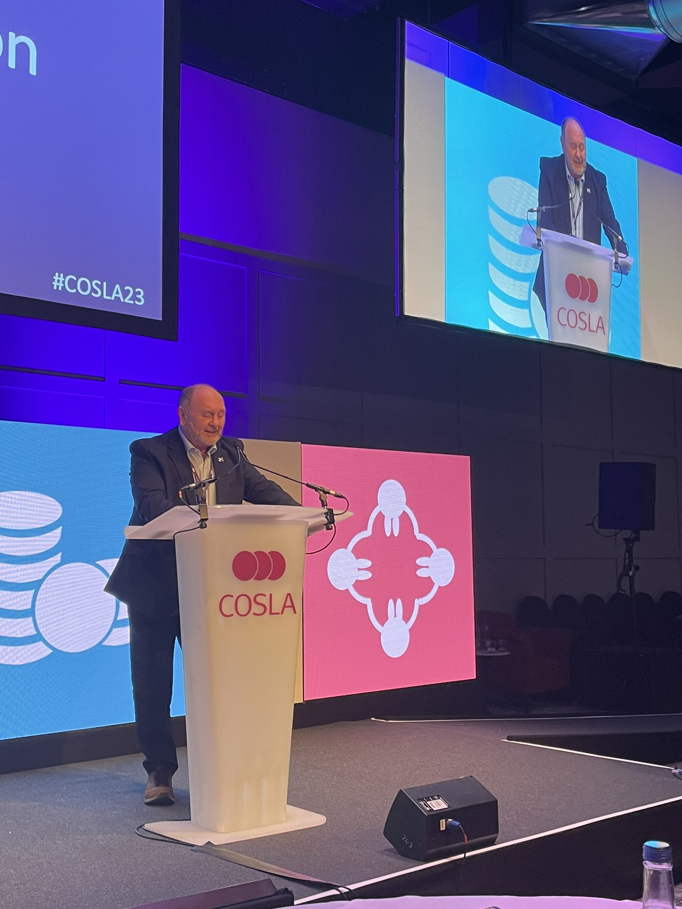
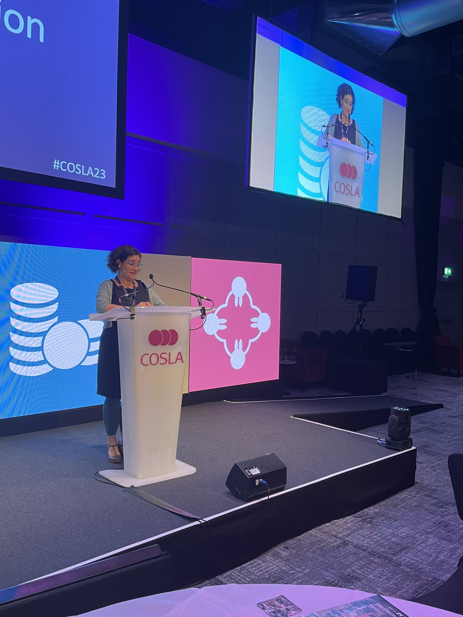
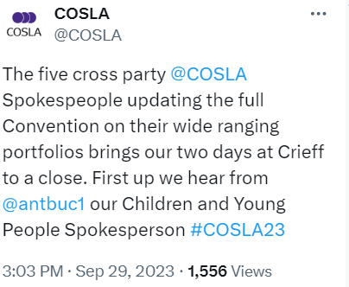

Slide 14
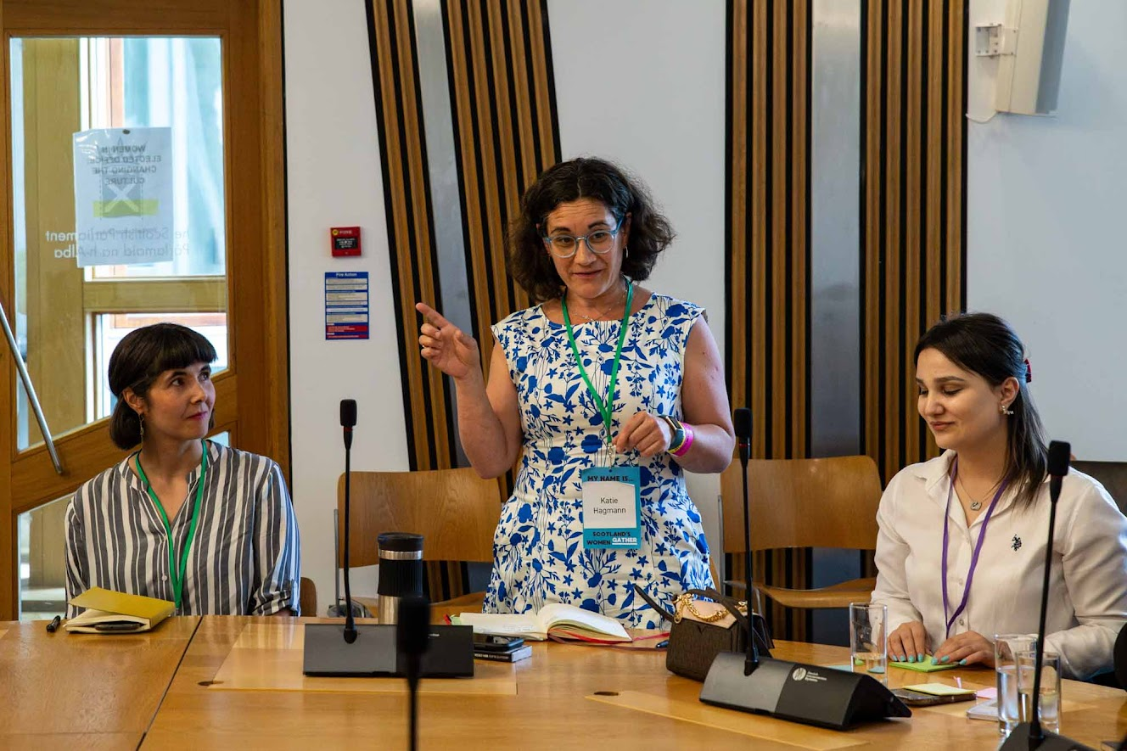
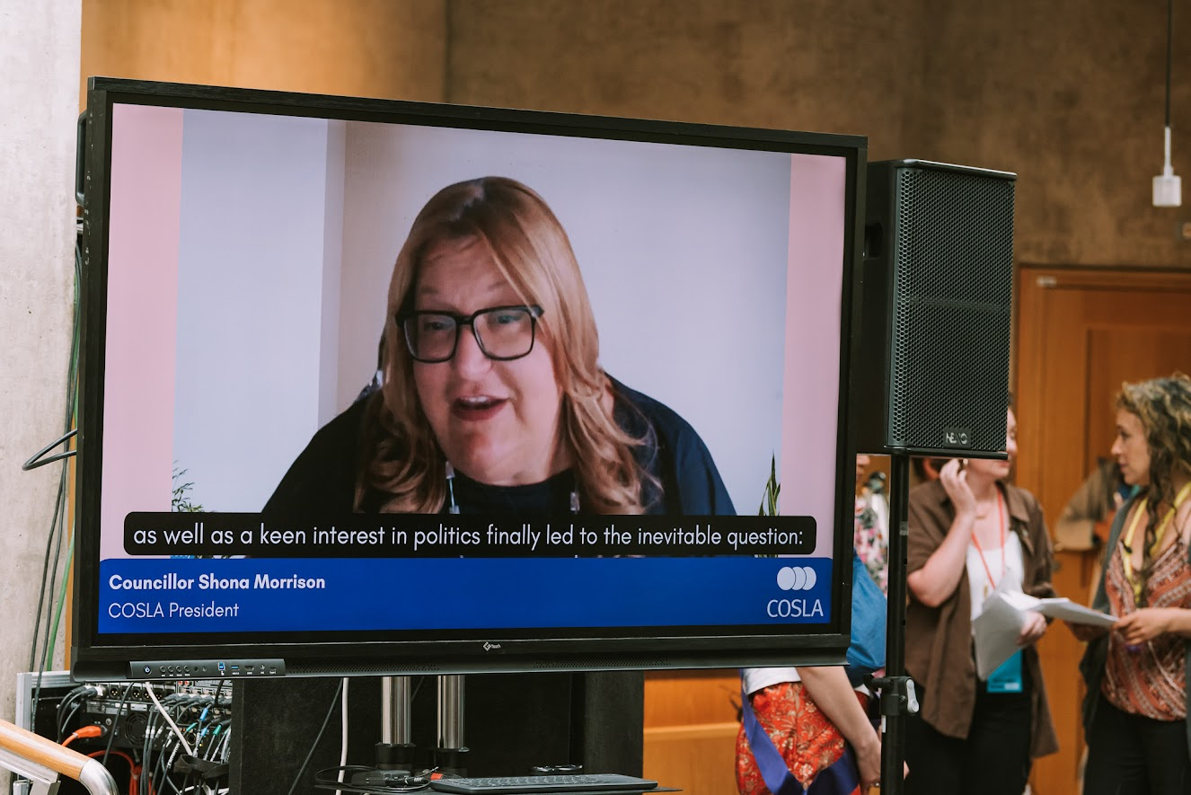
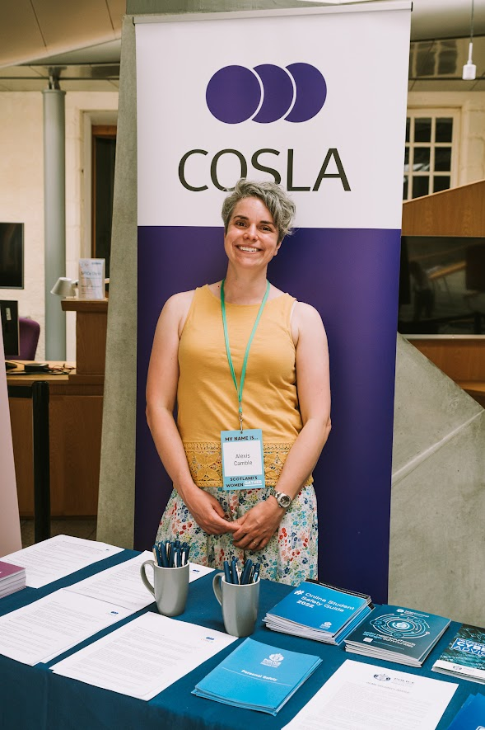
Arguing for fairness and equity in all of our communities….

Slide 15
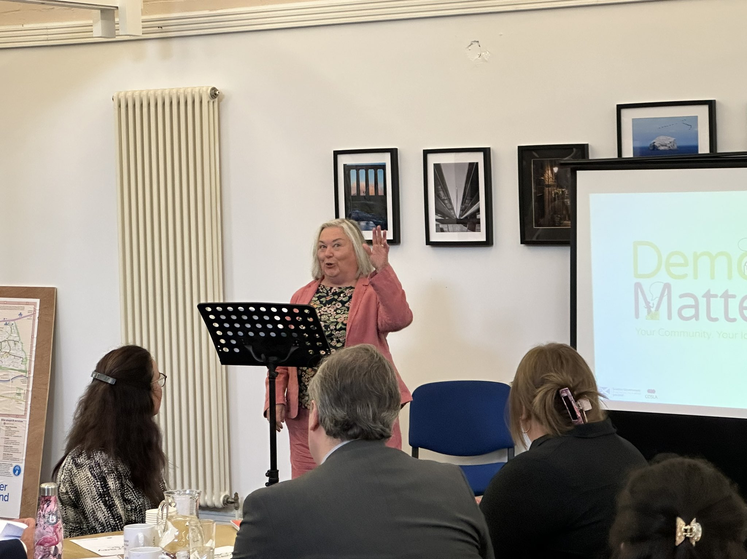
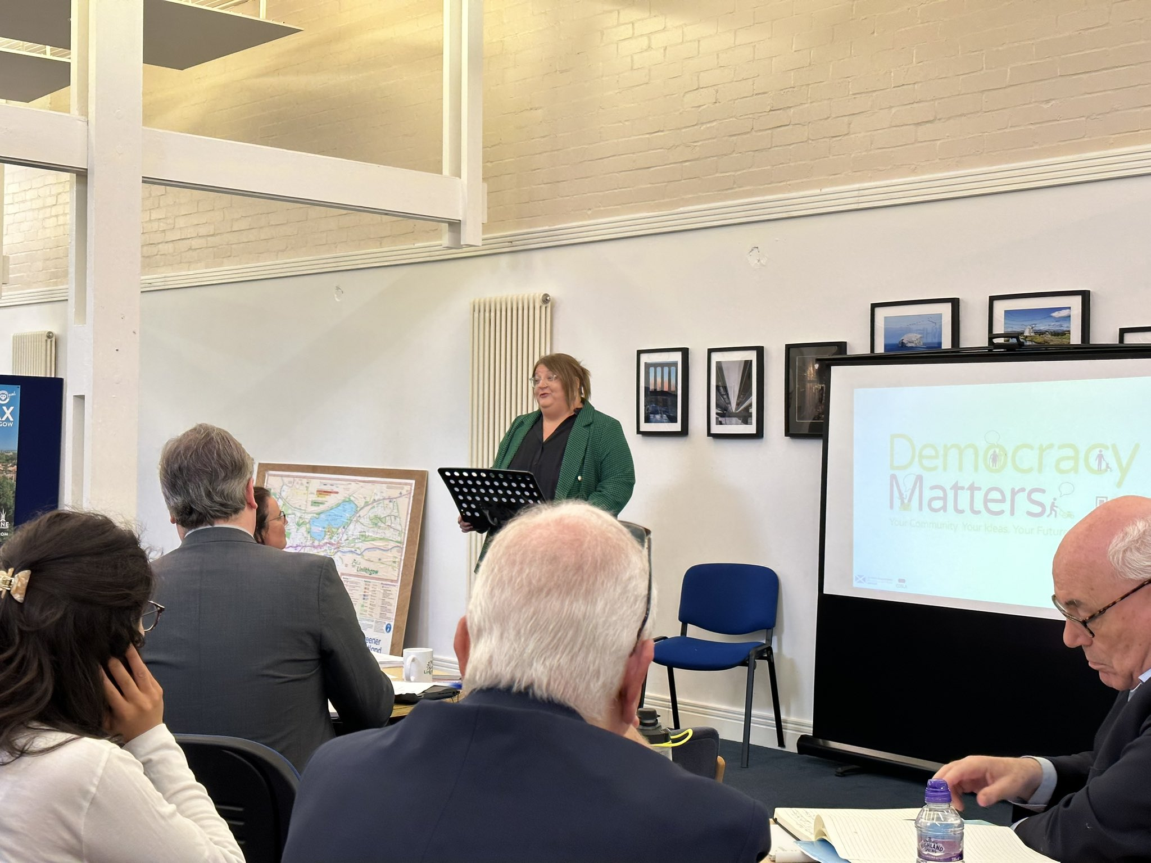
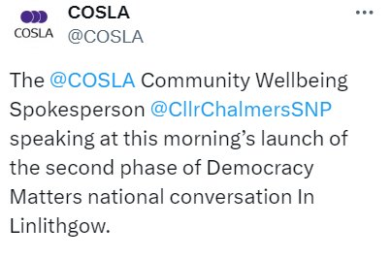
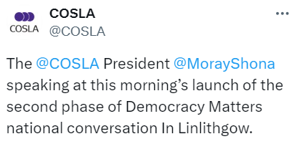
Strengthening Local Democracy….

Slide 16
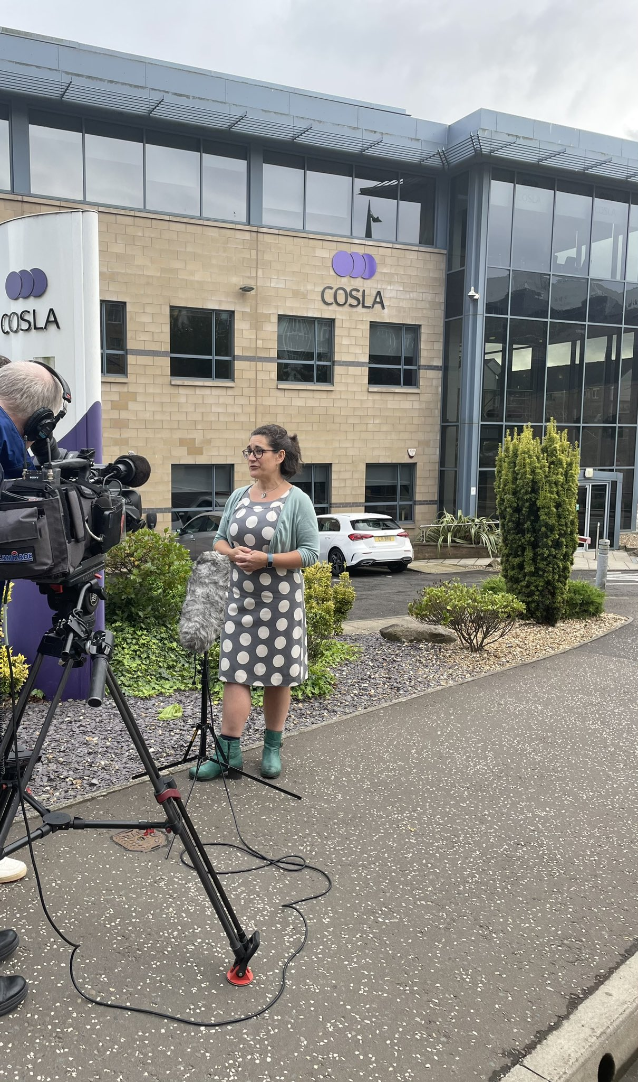
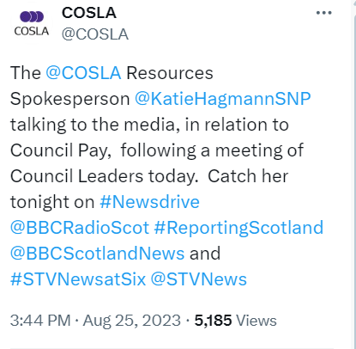
Negotiating for and with our workforce representatives to ensure strong pay and terms and conditions…

Slide 17
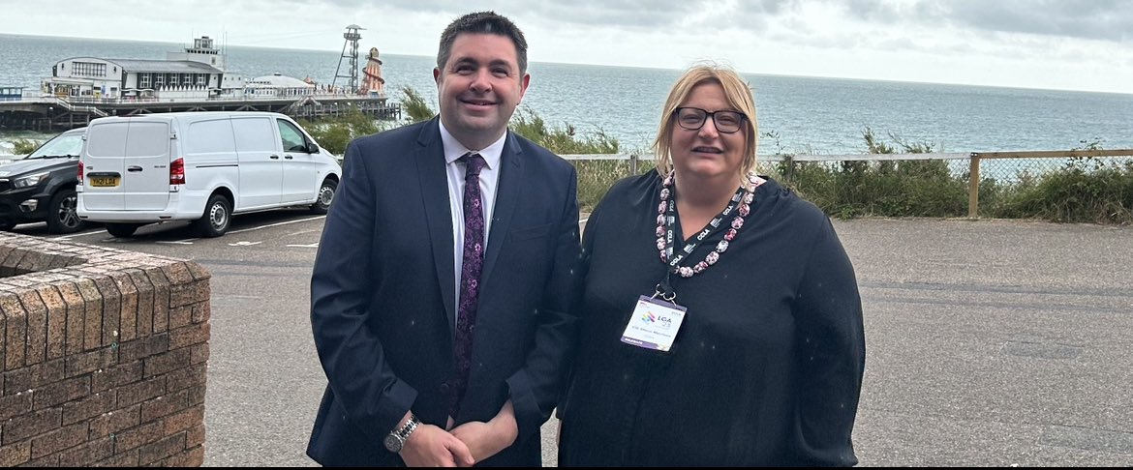
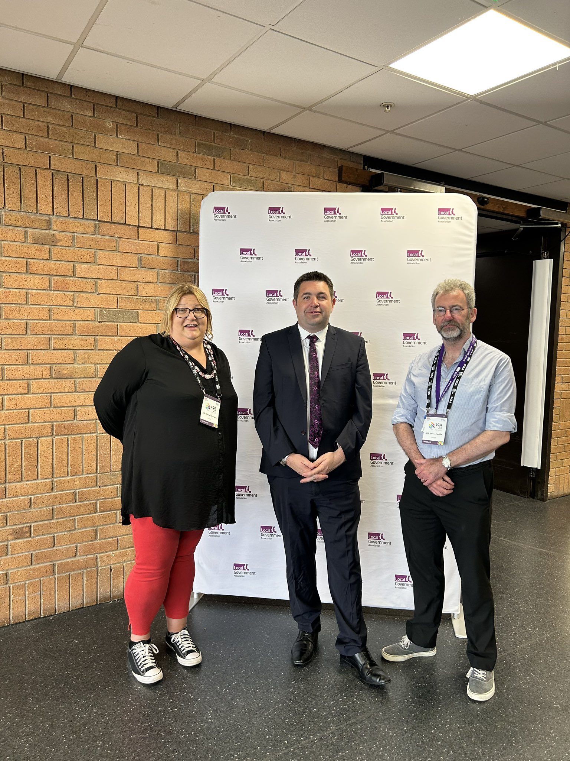
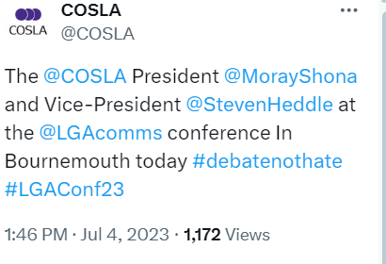

Slide 18
Local Government, Housing and Planning Committee, Tuesday 23rd May 2023
Giving evidence to Parliament and lobbying for Scottish Local Government…
Equalities, Human Rights and Civil Justice Committee, Tuesday 31st October 2023
Local Government, Housing and Planning Committee, Tuesday 20th February 2024

Slide 19
Local Government, Housing and Planning Committee, Tuesday 16th January 2024
Giving evidence to Parliament and lobbying for Scottish Local Government

Slide 20
Local Government, Housing and Planning Committee, Tuesday 5th September 2023
Giving evidence to Parliament and lobbying for Scottish Local Government

Slide 21
Giving evidence to Parliament and lobbying for Scottish Local Government….

Slide 22
‘your representative voice’

